Slide 1
Day 5 – Team 1 Group Pi
Windows Account Management

Slide 2
Windows 7/xp

Slide 3
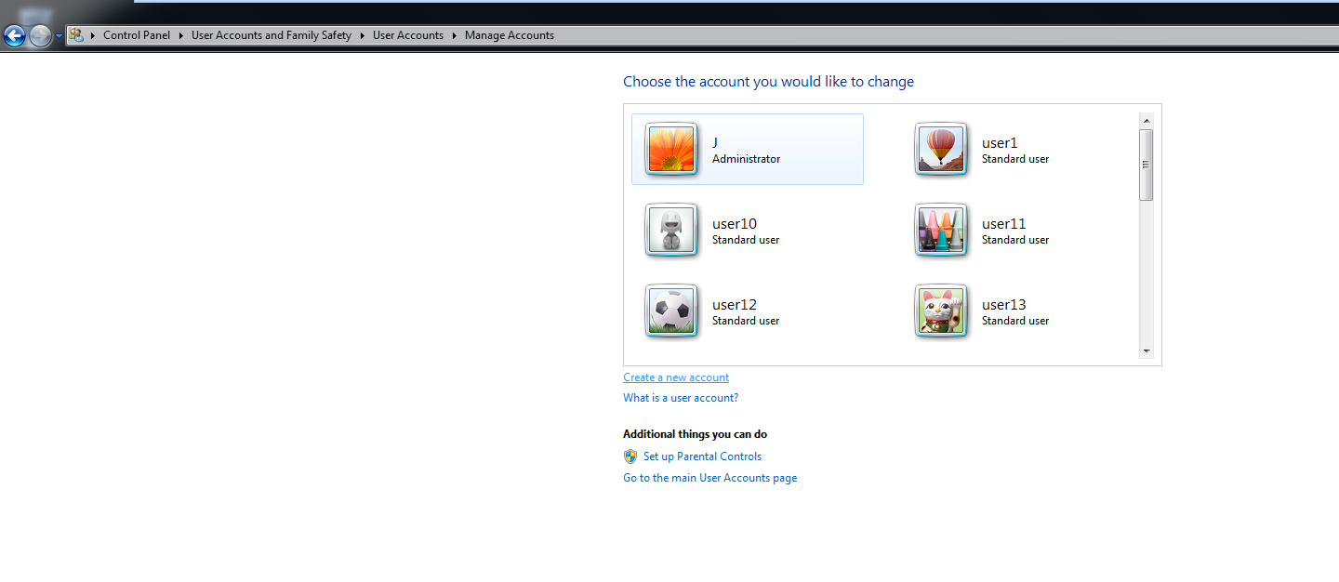
Add 15 users with usernames user1 through user15

Slide 4
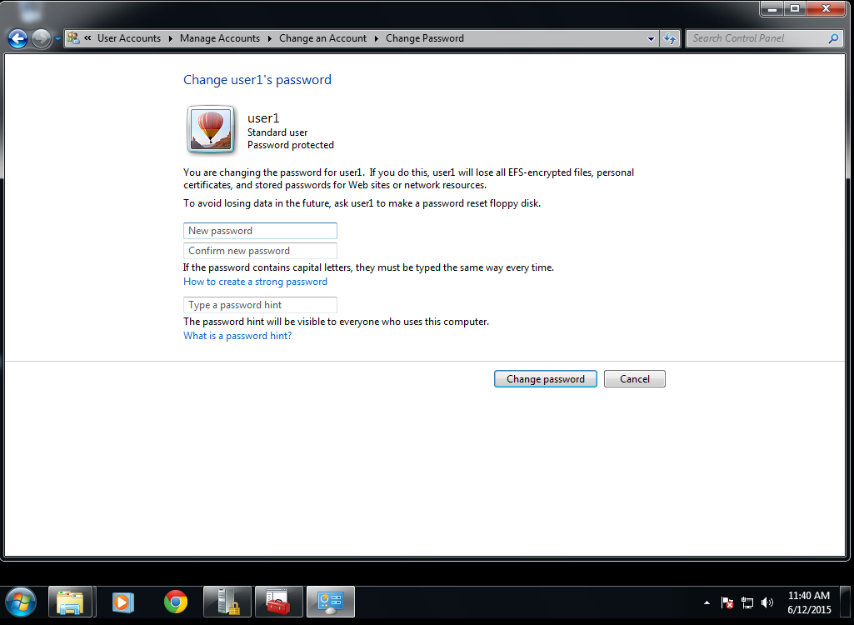
Create Passwords for users 1-10

Slide 5
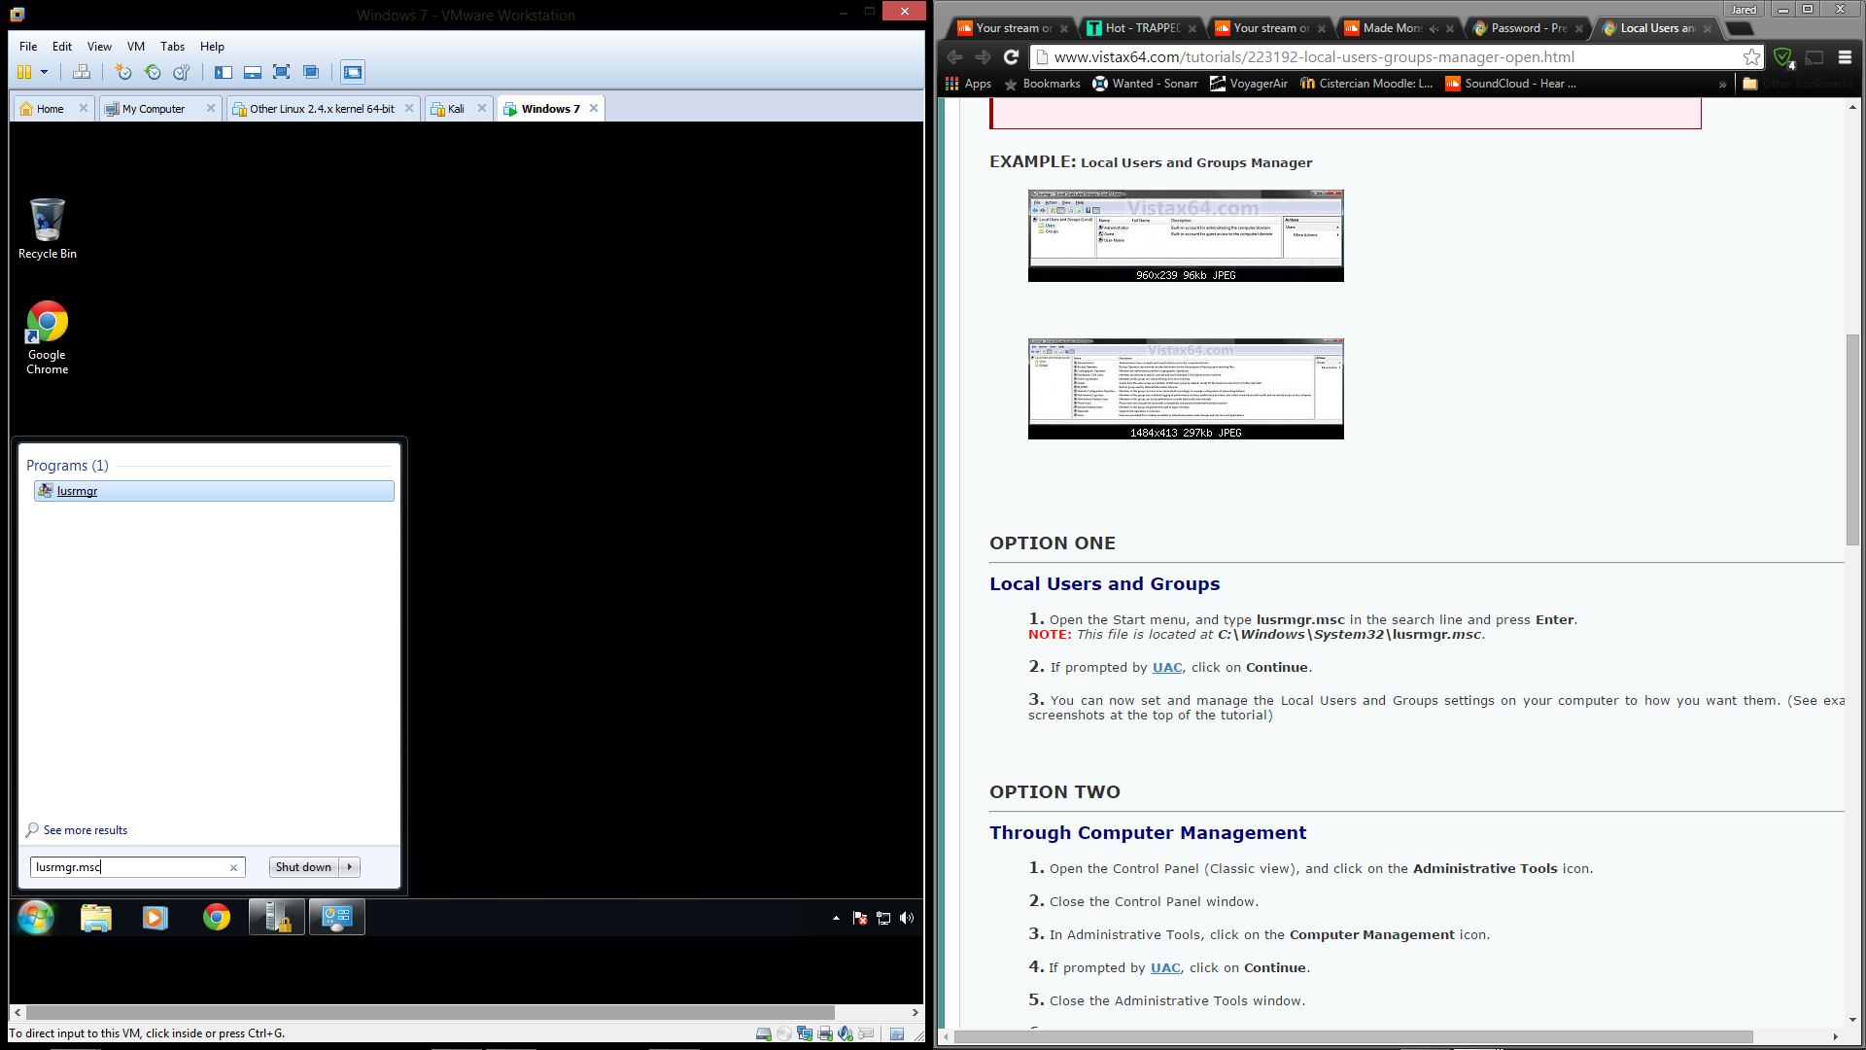
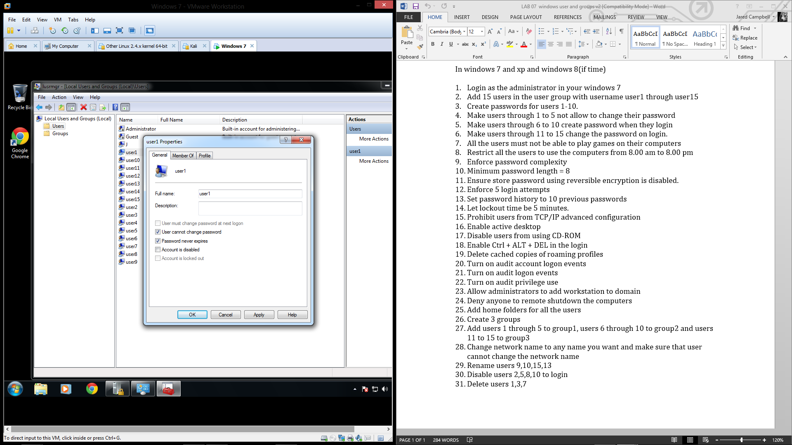
Make users 1-5 not allowed to change their password

Slide 6
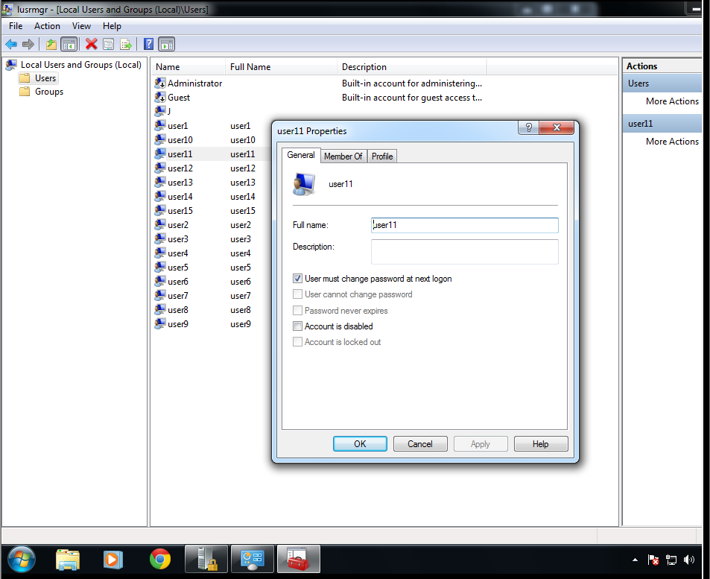
Make users 11-15 change their password at login

Slide 7
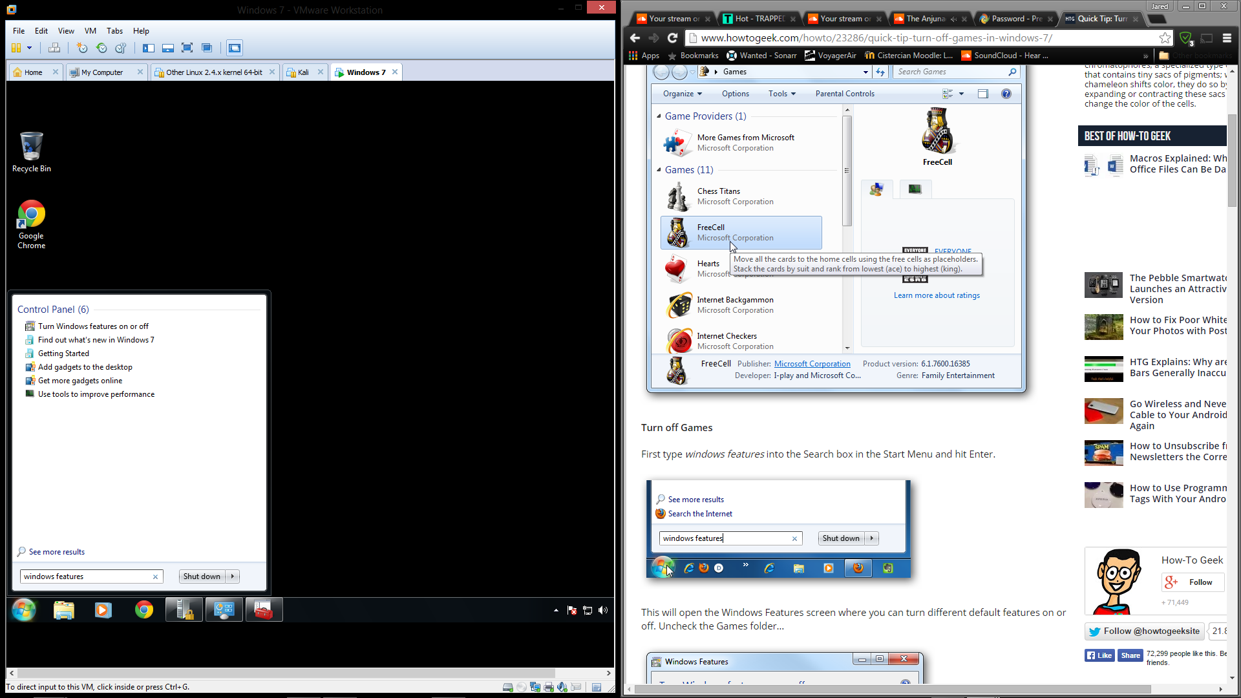
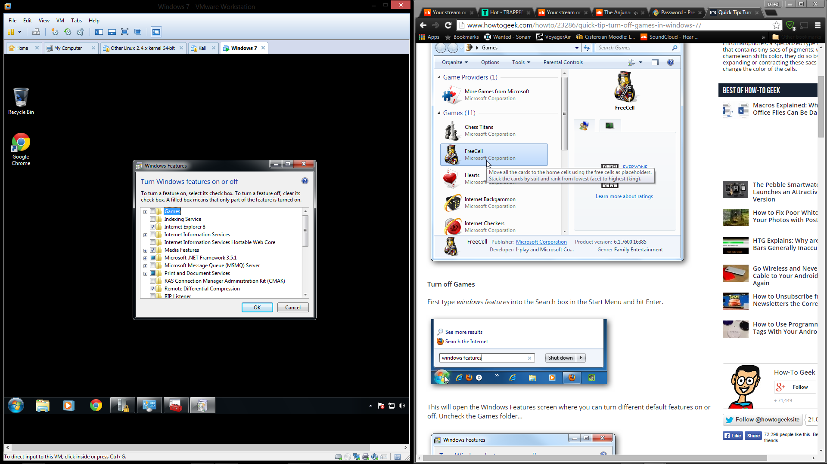
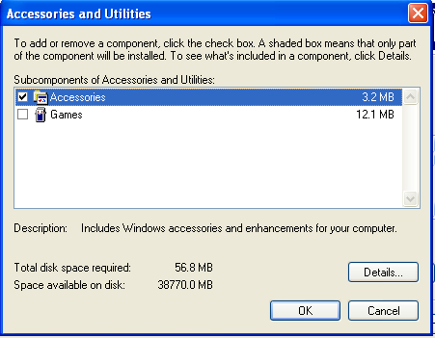
All the users must not be able to play games
Windows 7
Windows XP

Slide 8
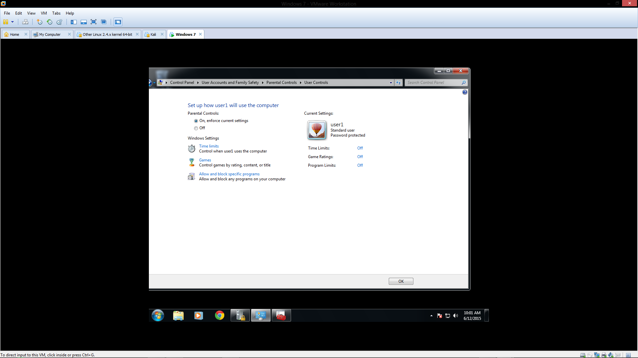
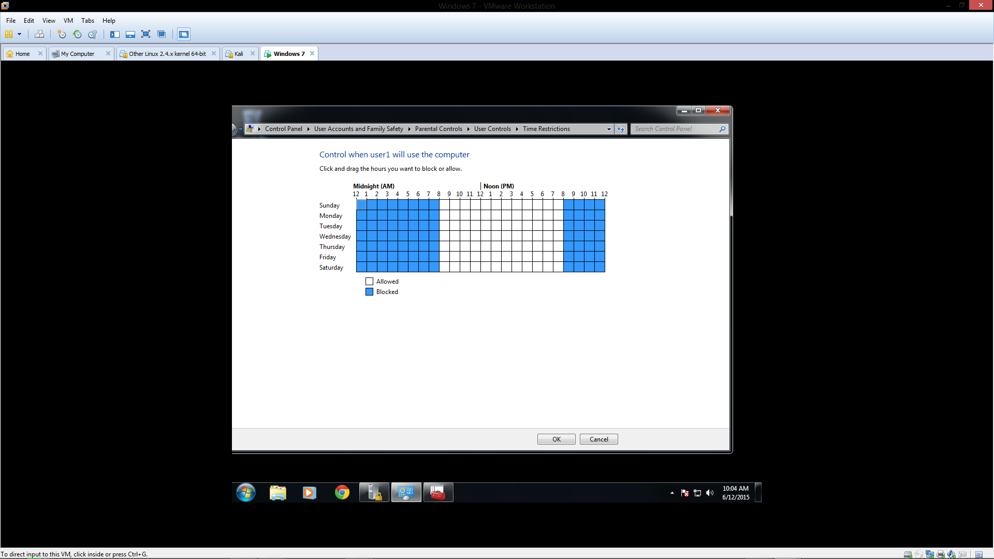
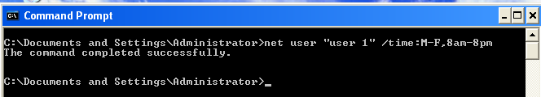
Restrict all the users to use the computers only from 8:00AM to 8:00PM
Windows 7
Windows XP

Slide 9
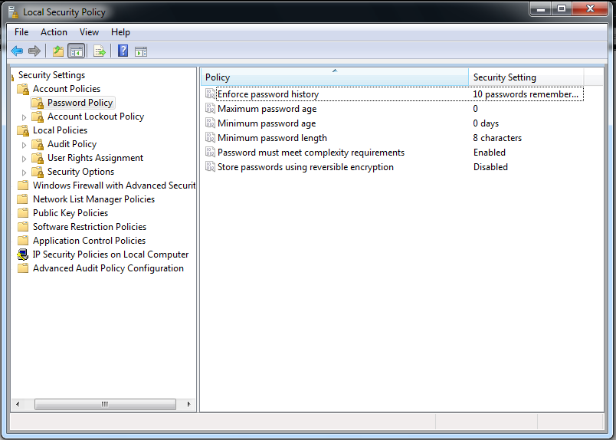
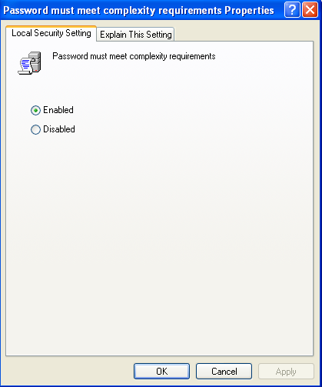
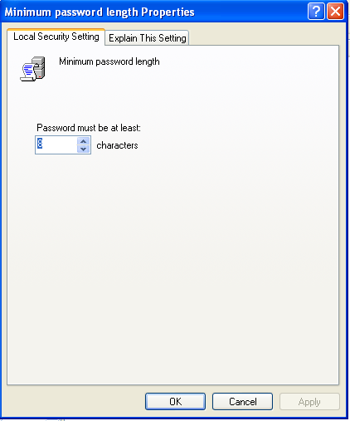
Enforce password complexity
Minimum password length=8
Ensure store password using reversible decryption is disabled
Set password history to 10 previous passwords
Windows 7
Windows XP

Slide 10
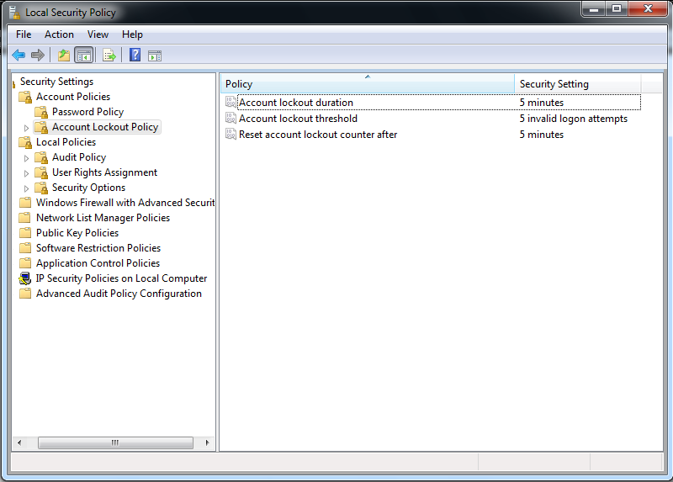
Enforce 5 login attempts
Let lockout time be 5 minutes

Slide 11
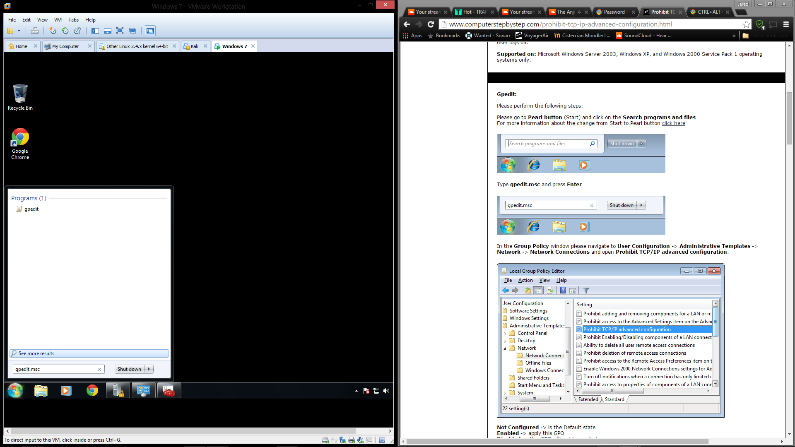
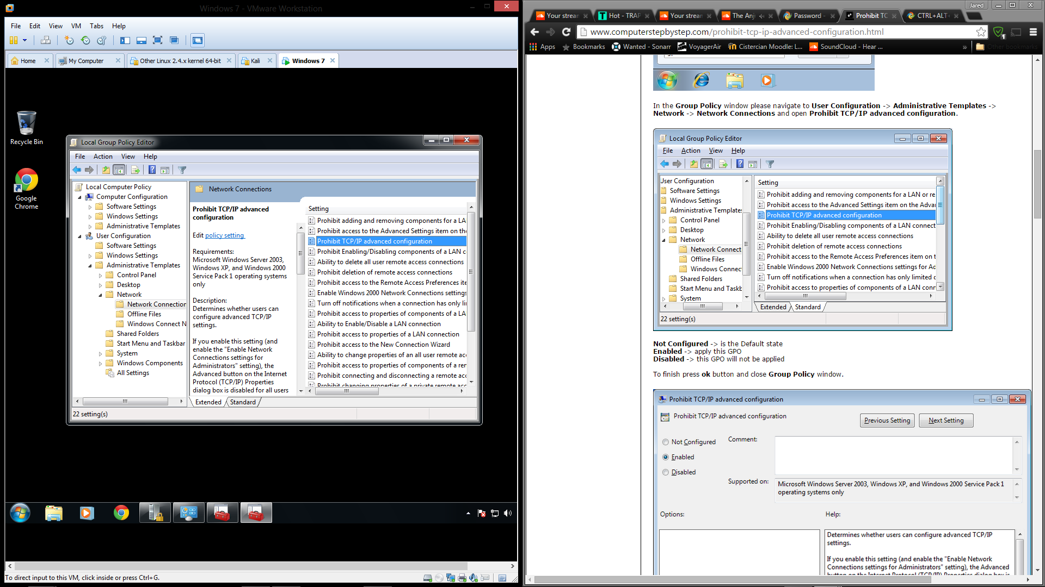
Prohibit users from TCP/IP advanced configuration

Slide 12
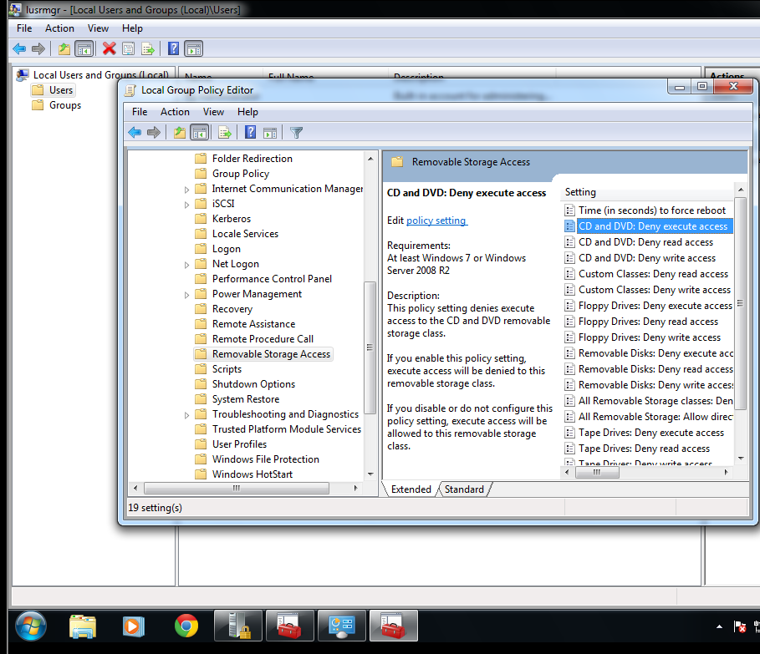
Disable users from using CD-ROM

Slide 13
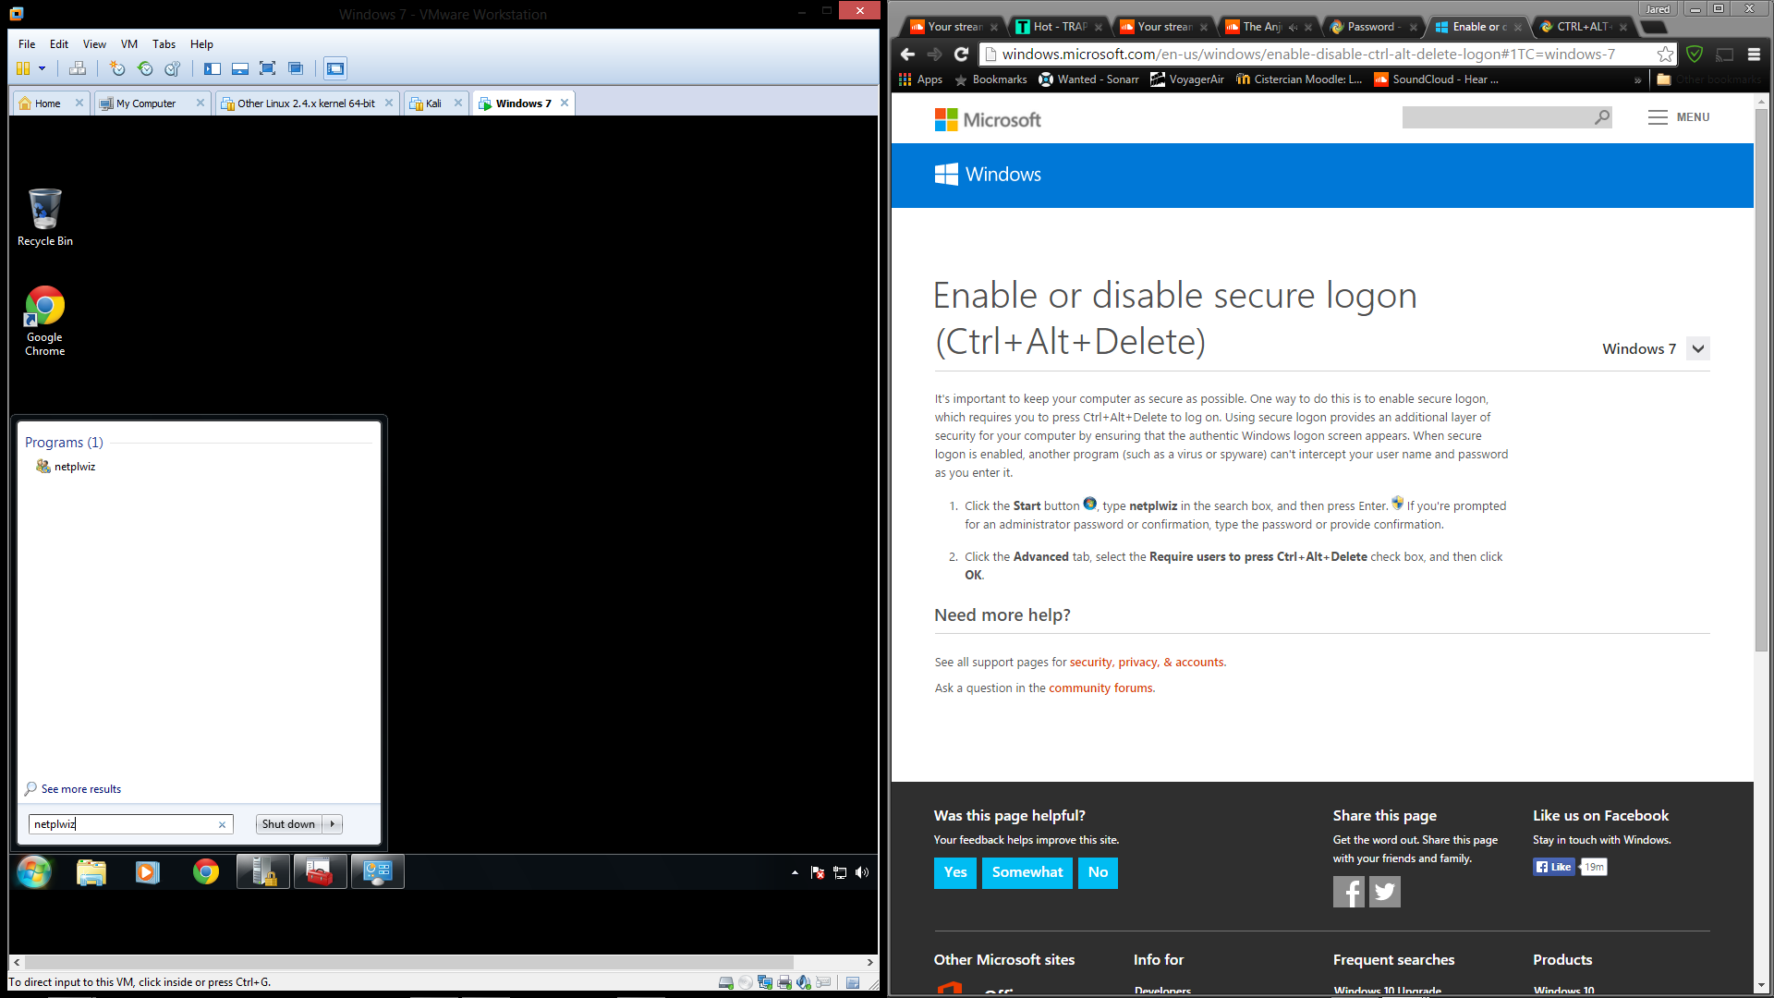
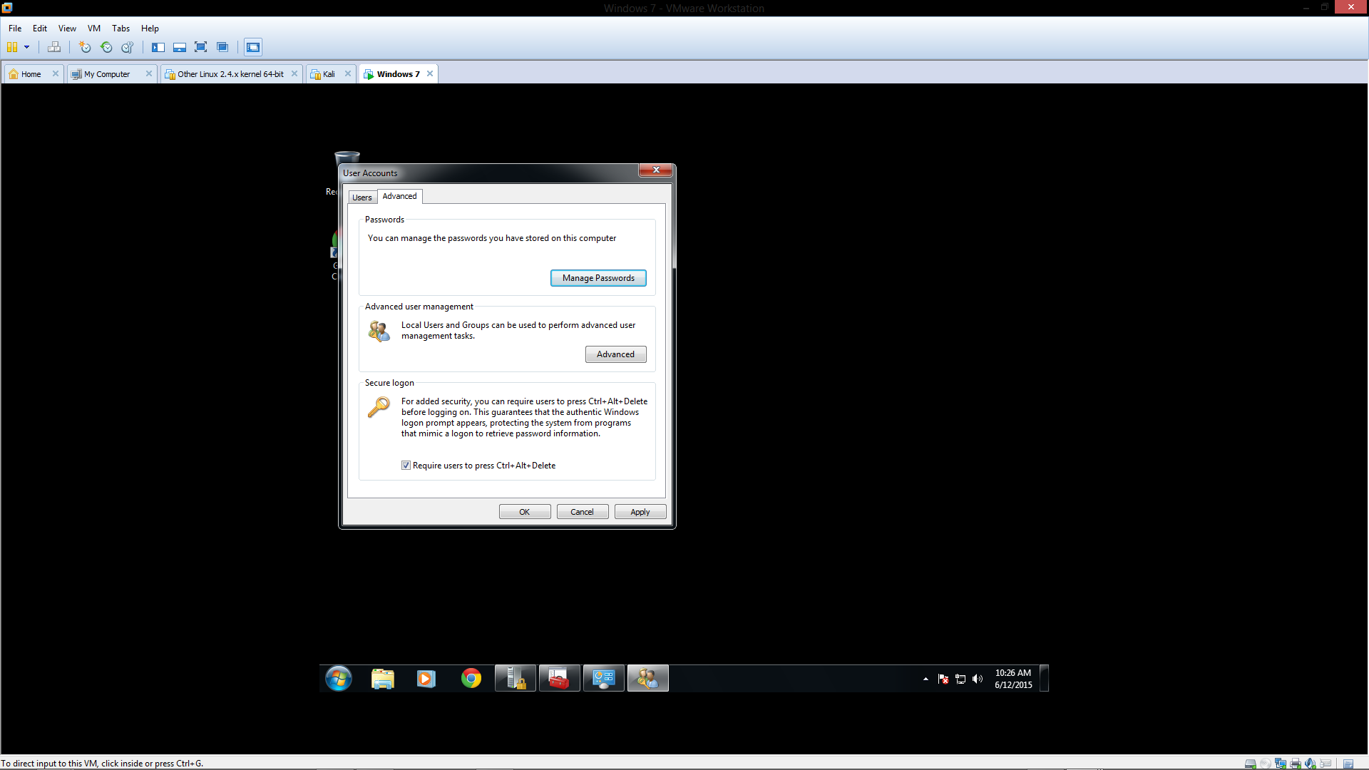
Enable CTRL+ALT+DEL in the login

Slide 14
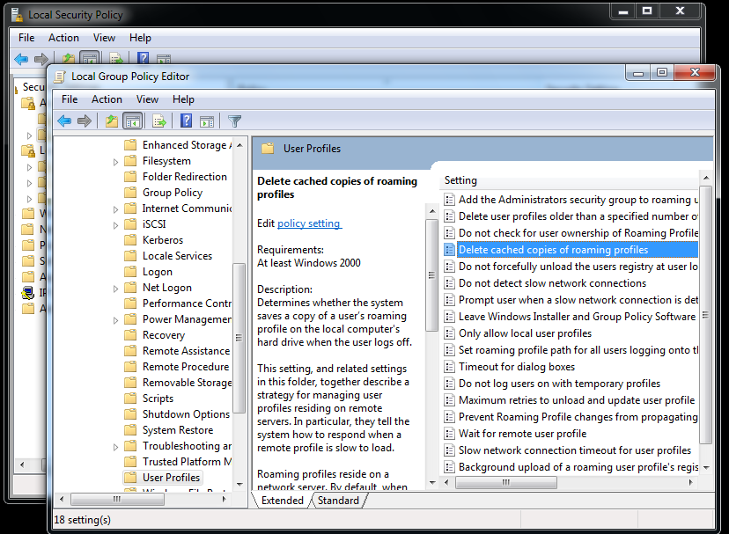
Delete cached copies of roaming profiles

Slide 15
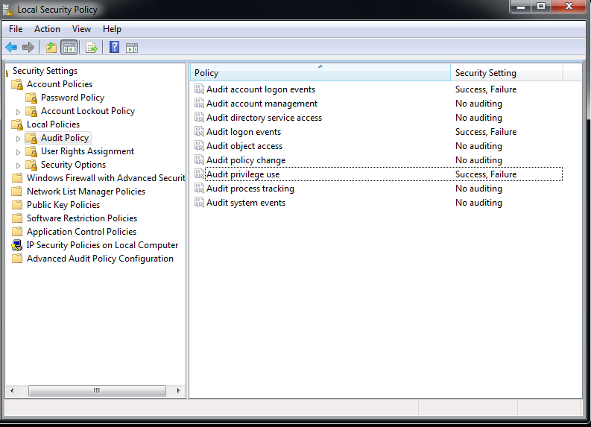
Turn on audit account logon events
Turn on audit logon events
Turn on audit privilege use

Slide 16
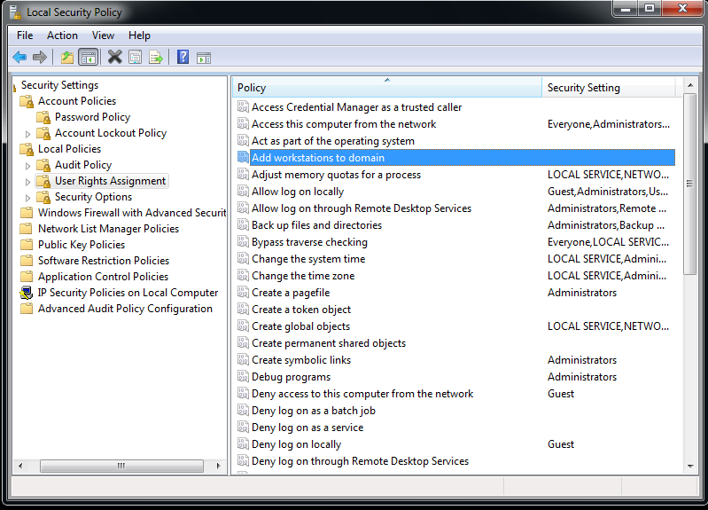
Allow administrators to add workstation to domain

Slide 17
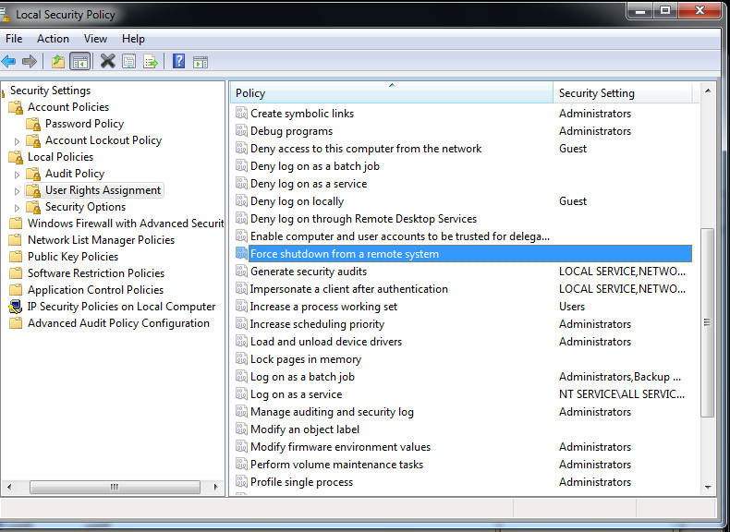
Deny anyone access to remote shutdown command

Slide 18
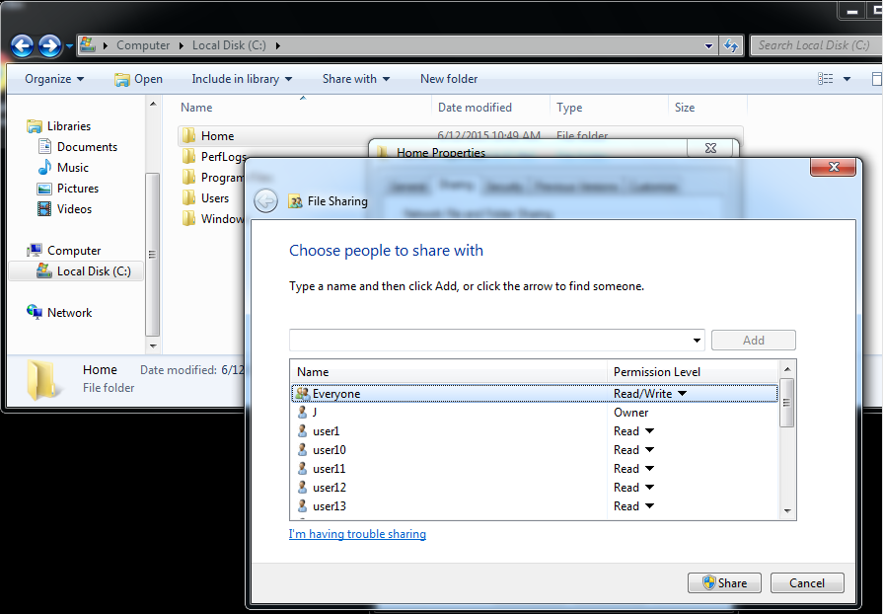
Add home folders for all users

Slide 19
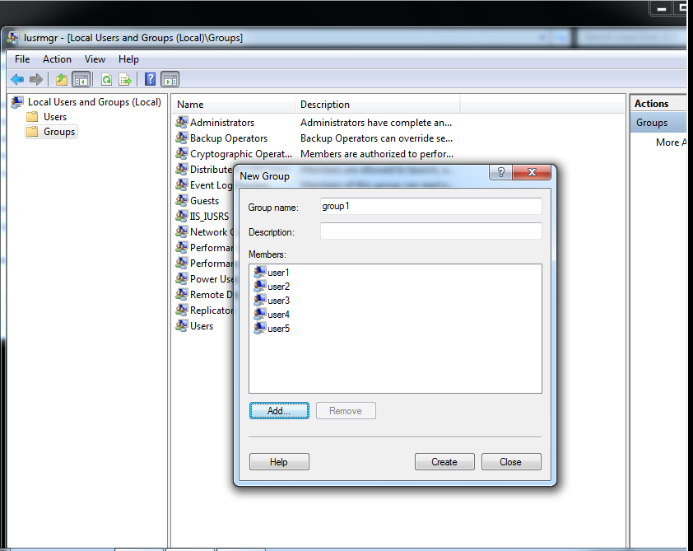
Create 3 groups:
group1: users 1-5
group2: users 6-10
group3: users 11-15

Slide 20
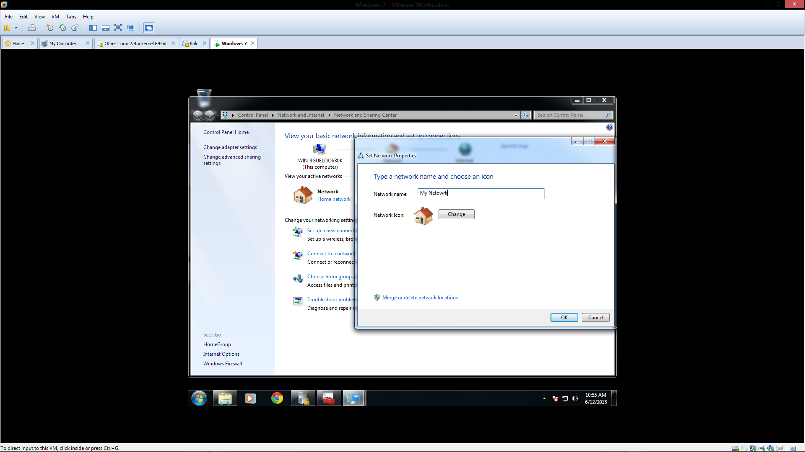
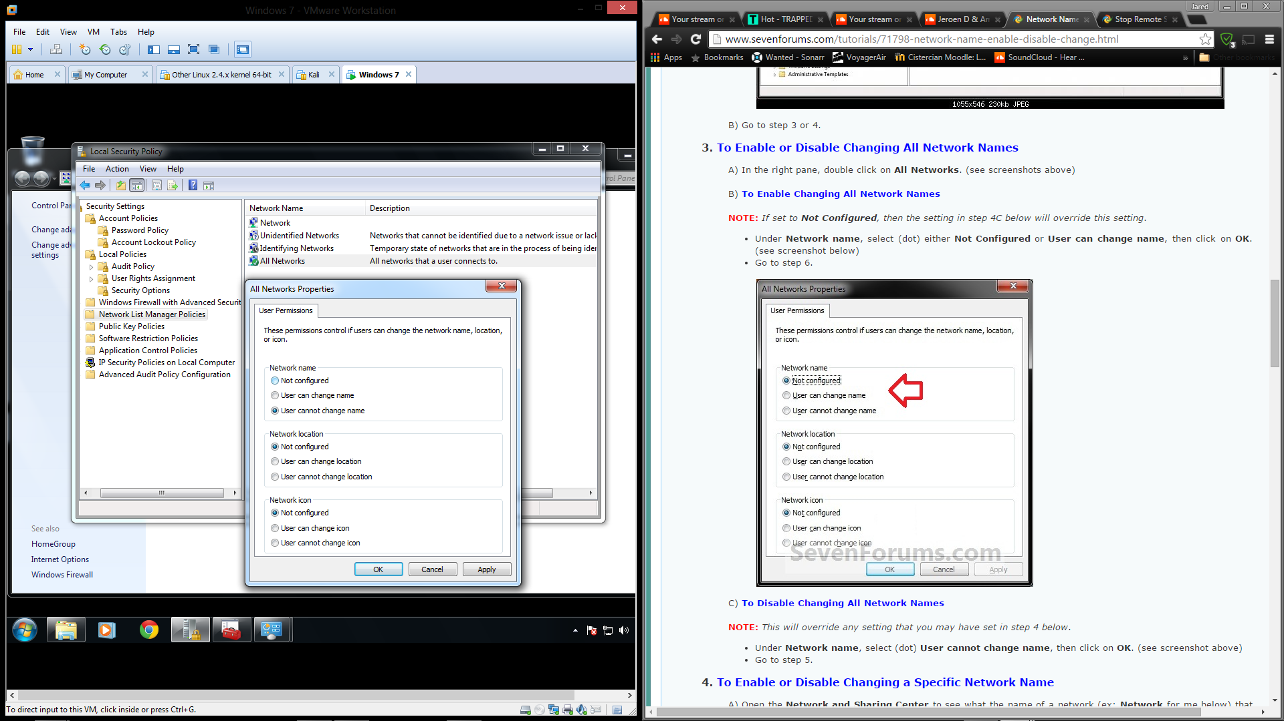
Change network name and prevent other users from changing it

Slide 21
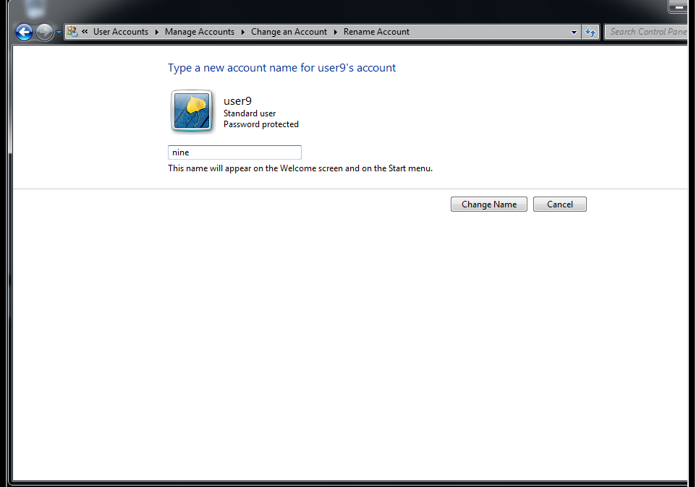
Rename users 9, 10, 15, 13

Slide 22
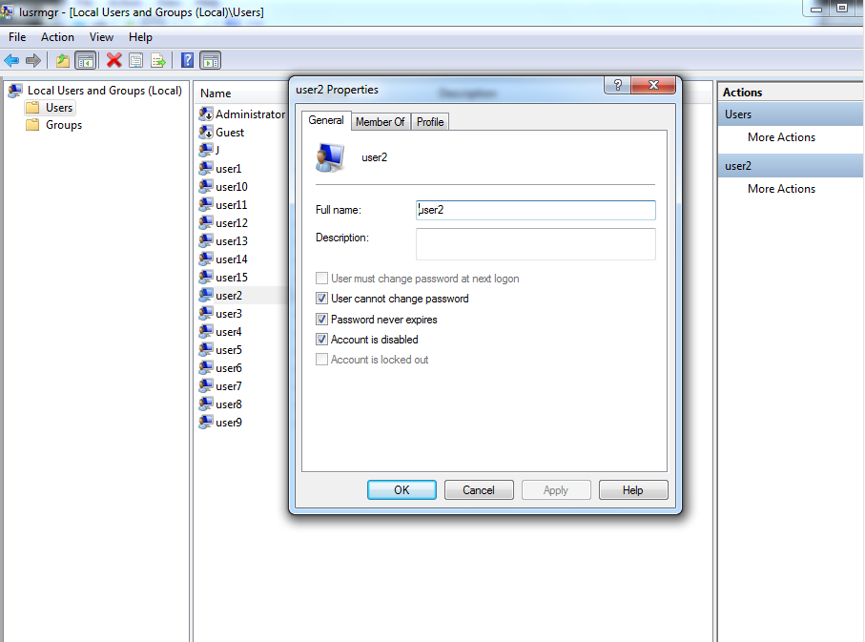
Disable users 2, 5, 8, 10 at login

Slide 23
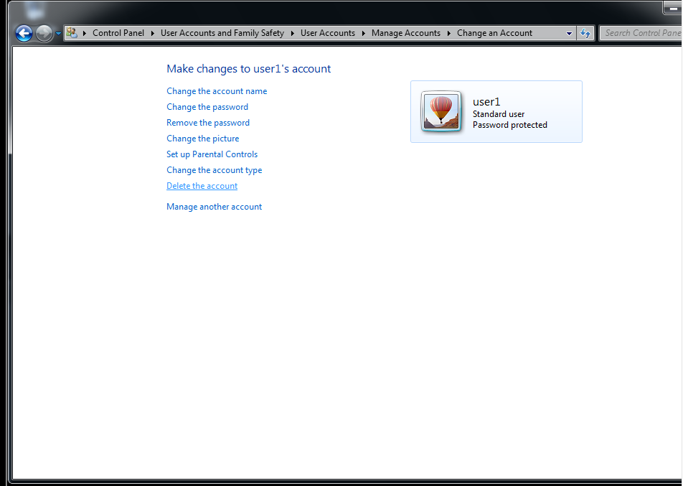
Delete users 1, 3, 7

Slide 24
Windows 8.1
Any processes similar to Windows 7 will not be covered.

Slide 25
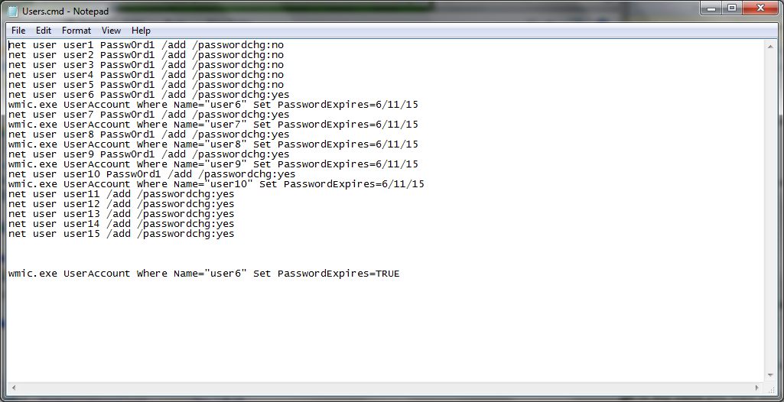
Add 15 users with usernames user1 through user15
Create Passwords for users 1-10
Make users 1-5 not allowed to change their password
Make users 6-10 change their password at login
All these were completed at the same time with a small batch script.

Slide 26
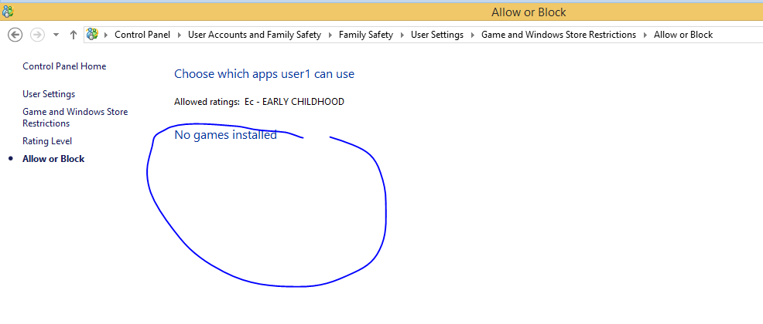
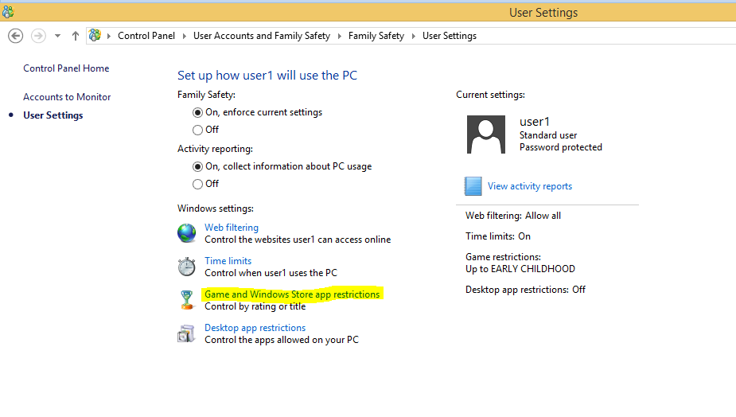
All the users must not be able to play games on their computers
Disable any games that are listed.

Slide 27
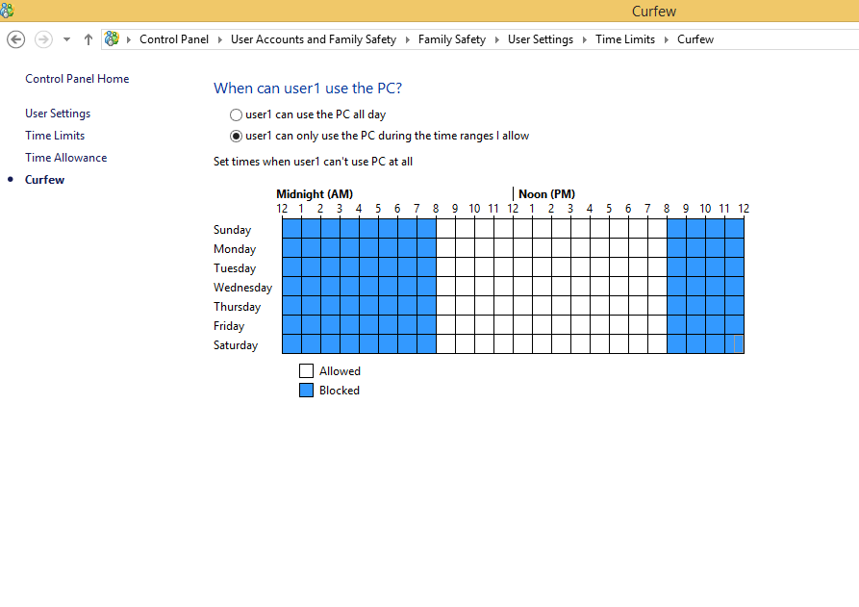
Restrict all the users to use the computers only from 8:00AM to 8:00PM
Open Control Panel->User Accounts and Family Safety->Family Safety->User Settings->Time Limits->Curfew. Highlight all disallowed time.

Slide 28
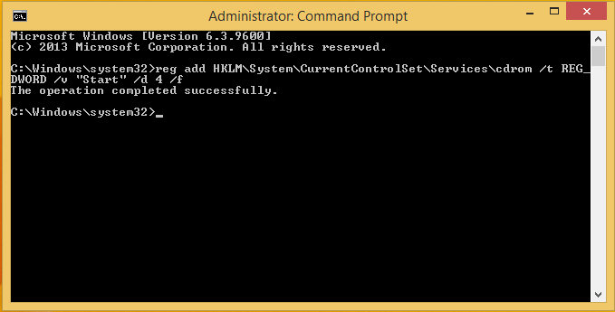
Disable users from using CD-ROM
Run cmd as admin. Type in shown command. Will disable CD-ROM.

Slide 29
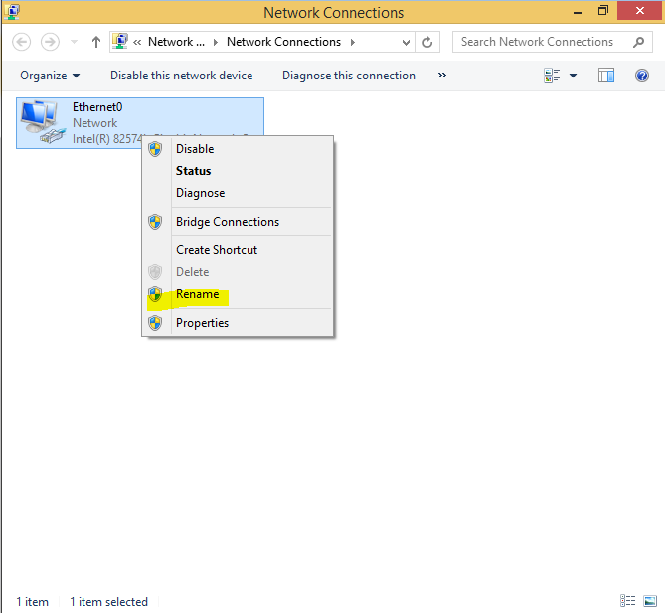
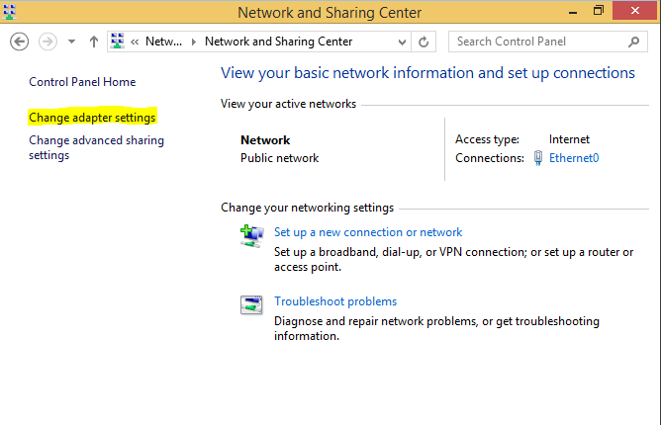
Change network name
In the networking and sharing center, in the left hand column click on ‘Change Adapter setting’. Right click network and select rename.

Slide 30
Resources
http://www.sevenforums.com/
http://windows.microsoft.com/en-us/windows/support#1TC=windows-8

